Slide 1
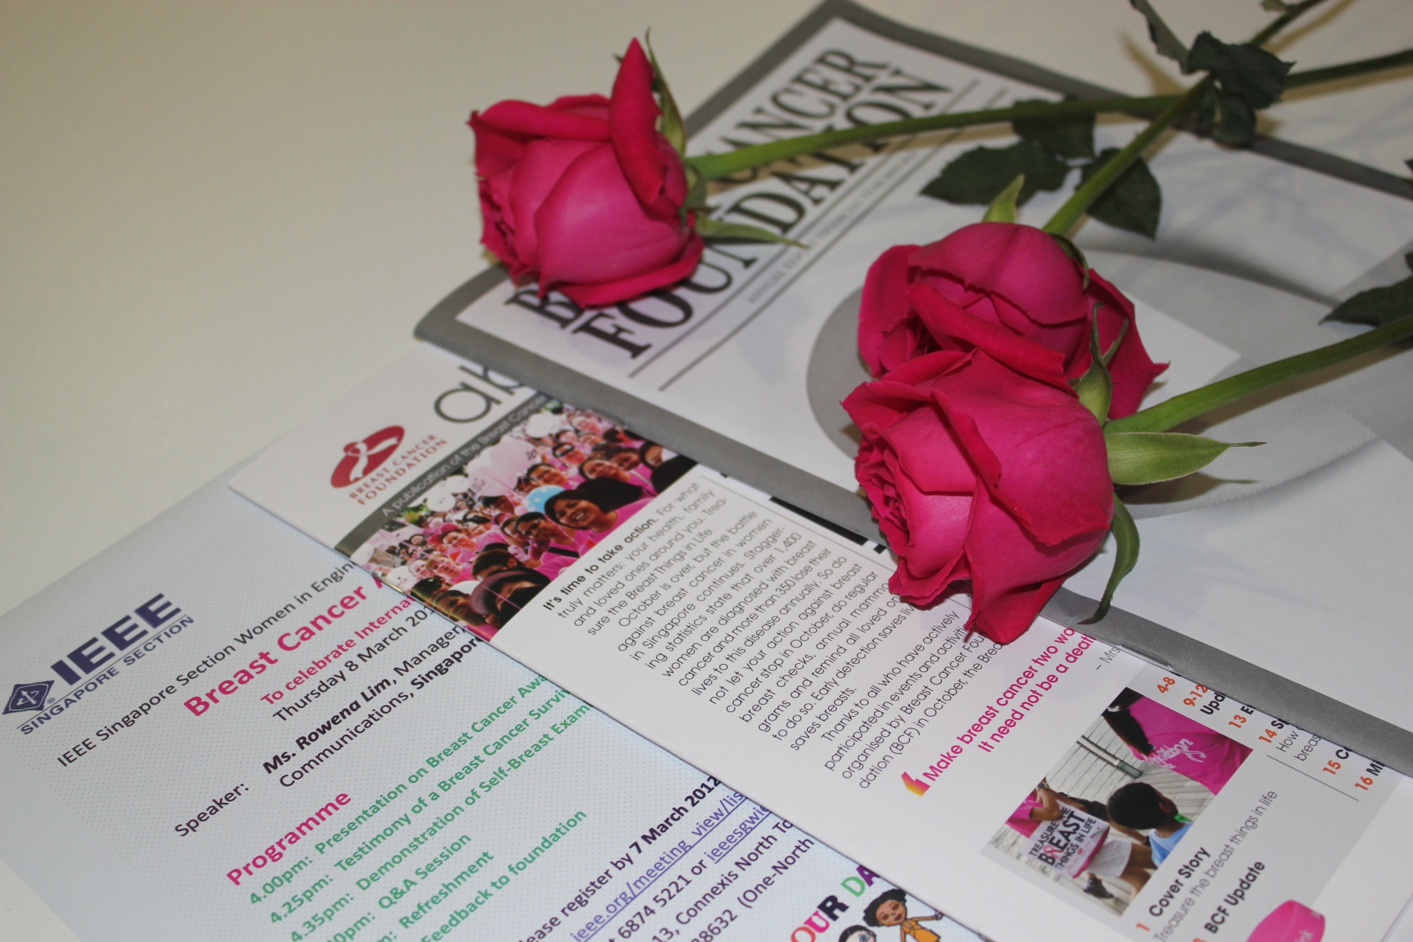
IEEE Singapore Section WIE proudly presents - Breast Cancer Awareness Talk
Potential 1, Connexis North Tower, Fusionopolis, 8th March 2012

Slide 2
Opening Speech from WIE Chairman

Slide 3
Presenter Ms. Rowena Lim, Manager, BCF

Slide 4
Attendees and Speaker

Slide 5
Each and every ladies got one rose ☺

Slide 6
Attendees and Speaker

Slide 7
BCF’s Mission

Slide 8
Breast Cancer is one of the Top Ten cancers in Singapore

Slide 9
Early Detection Schedule

Slide 10
Breast Cancer Campaign Ads- Body Art

Slide 11
Breast Cancer Campaign Ads- Body art- Paint on nude human body

Slide 12
Breast Cancer survivor in person

Slide 13
Answering one to one questions

Slide 14
Celebrate Women’s Day ☺

Slide 15
☺☺☺

Slide 16
Special Token from WIE to BCF

Slide 17
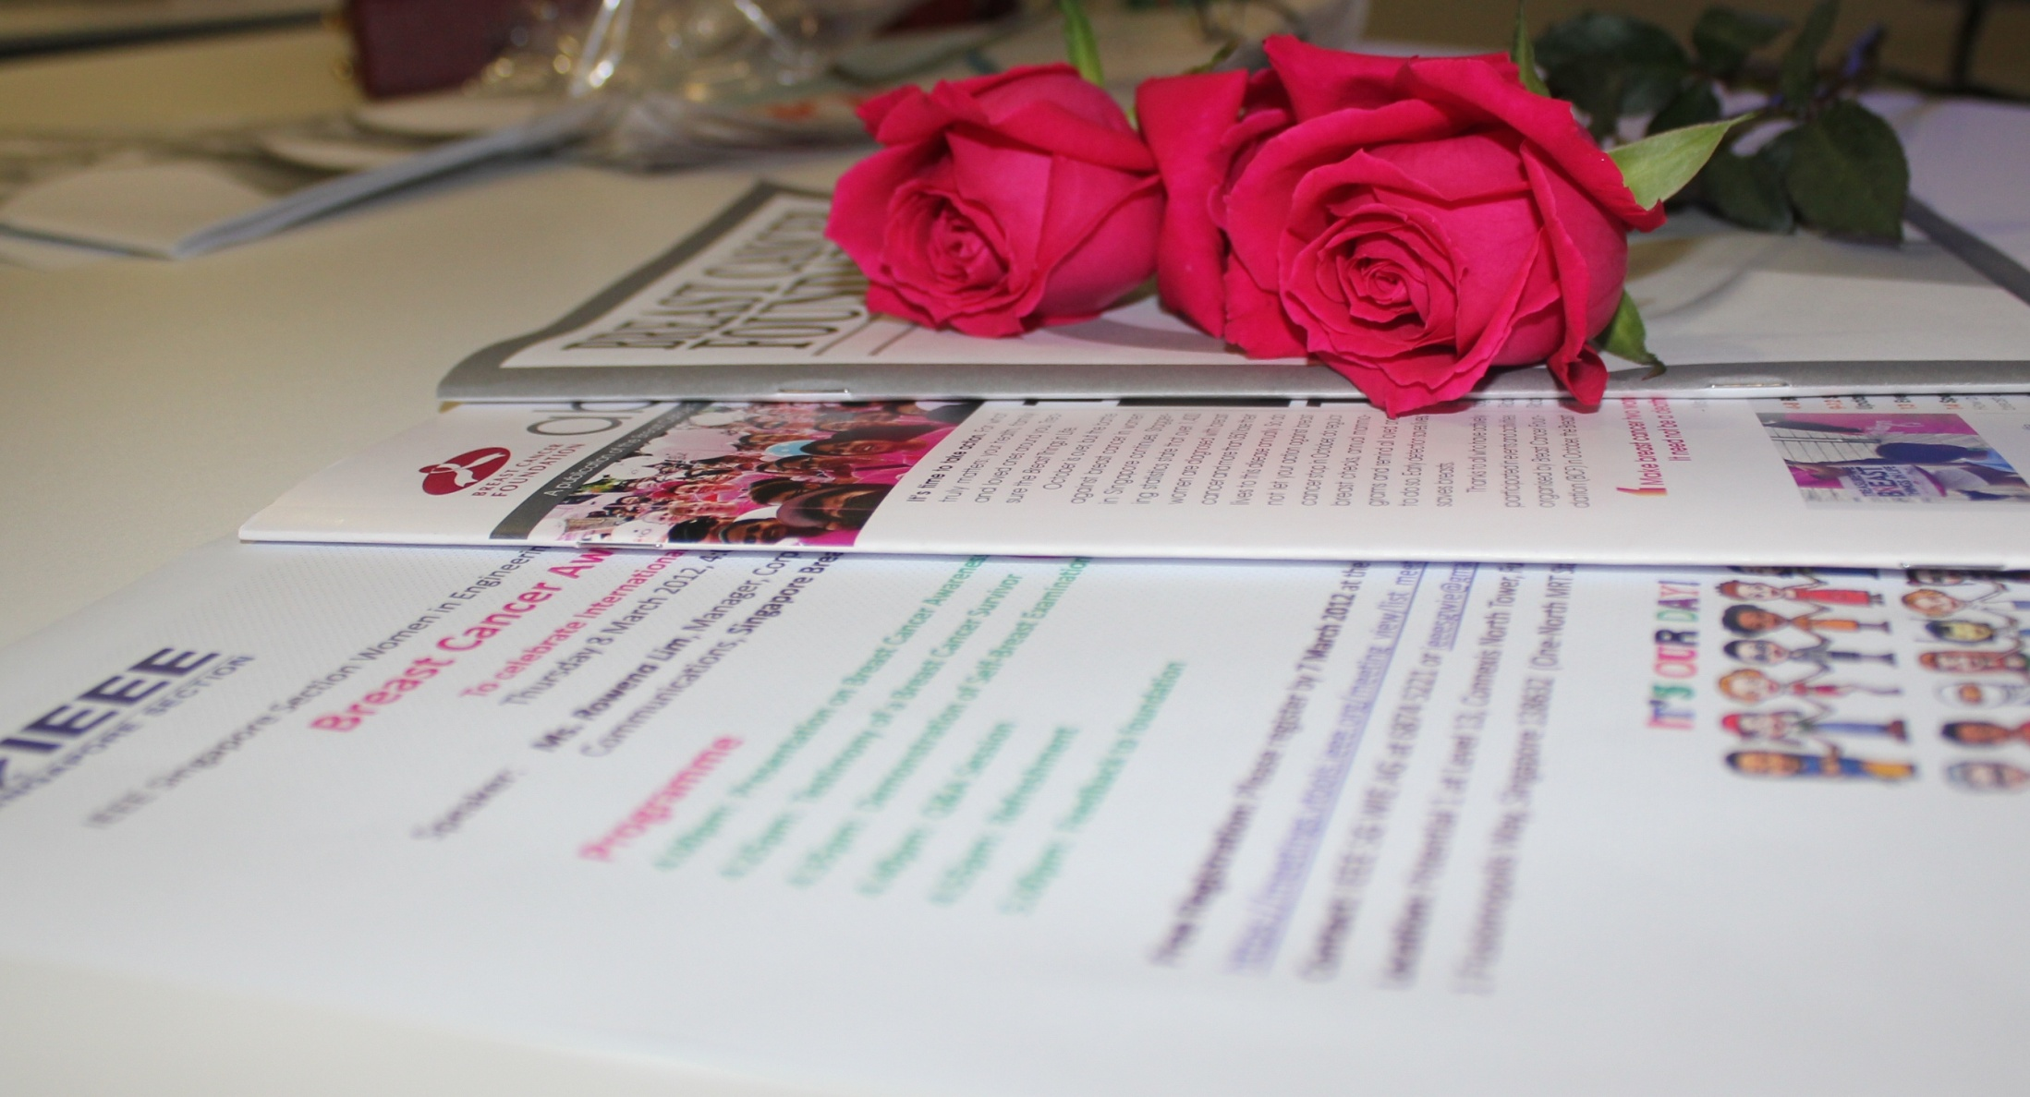
THANKS TO ALL OF Our WIE sg MEMBERS!

